Slide 1
What is public policy & why you should get involved in shaping it
Iglika Ivanova • iglika@policyalternatives.ca
Senior Economist • Public Interest Researcher
March 28, 2019

Slide 2
Overview
What is public policy and how it affects your life?
Who decides what becomes public policy in Canada?
Who does public policy serve?
Why we need you to get involved in shaping public policy?
Reflection activity

Slide 3
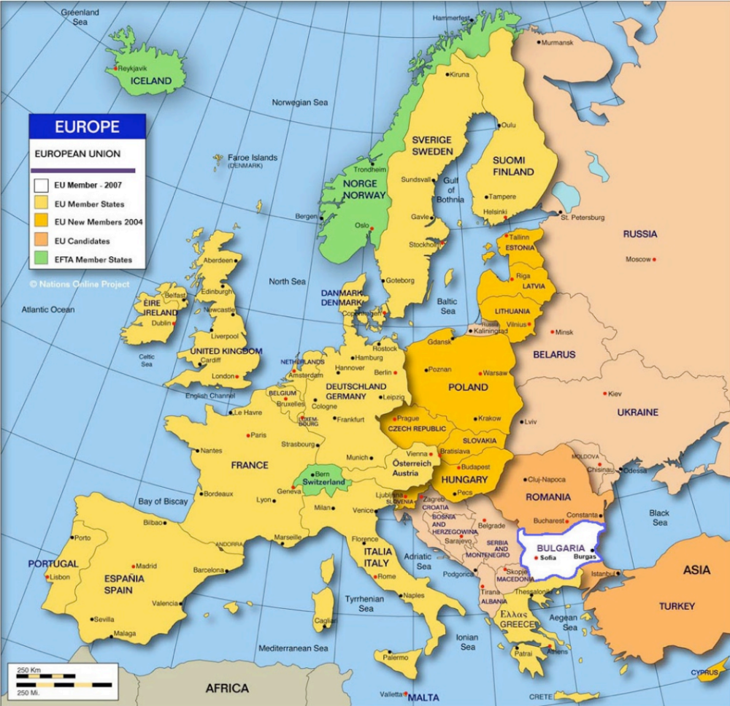

Slide 4
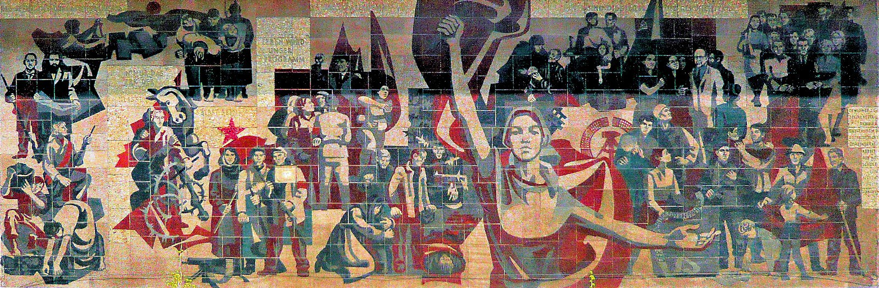

Slide 5
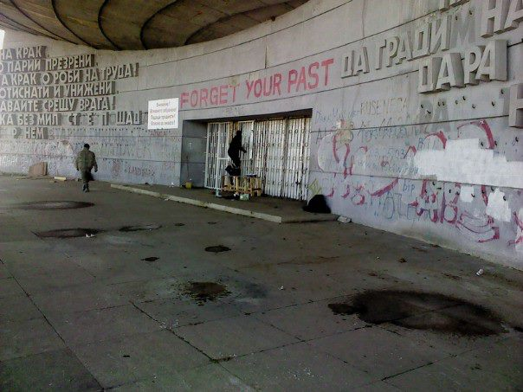

Slide 6


Slide 7
What is policy?
guidelines
principles
directions
rules
regulations
laws

Slide 8
What is public policy?
guidelines
principles
directions
rules
regulations
laws
… that guide how governments operate to address specific issues (incl. how to prioritize,

Slide 9
Public policy in your life

Slide 10
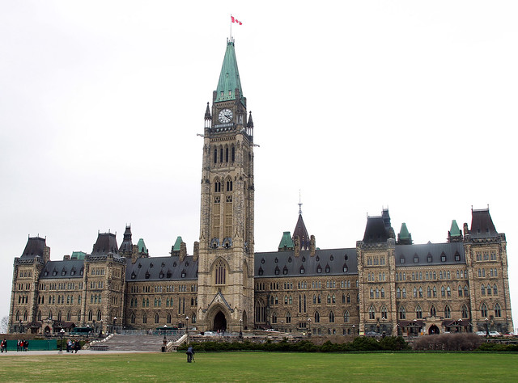
Who makes what public policy in Canada
Photo by Alex Guibord: https://www.flickr.com/photos/alexguibord/8727849928

Slide 11
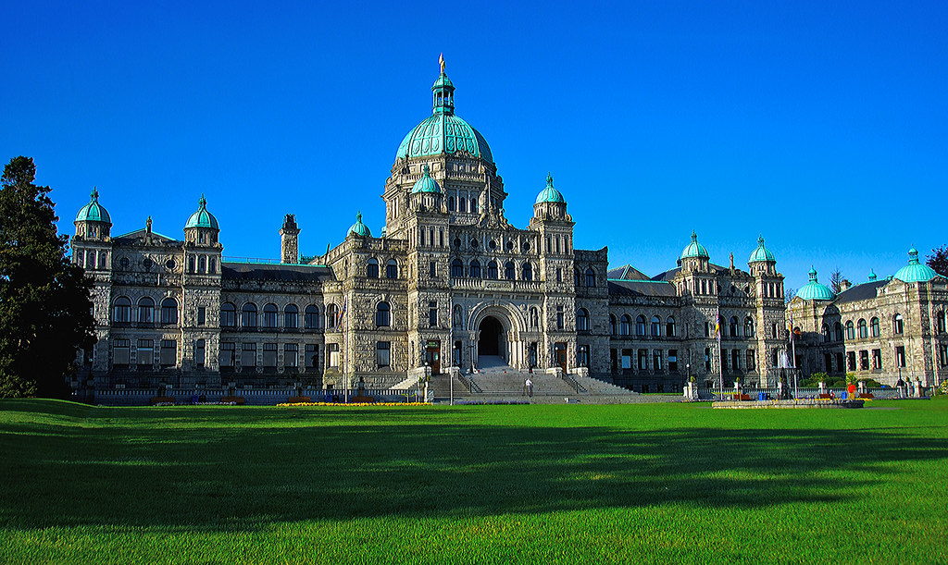
Who makes what public policy in Canada
Photo by WriterGal39: https://www.flickr.com/photos/writergal/4609461287/

Slide 12
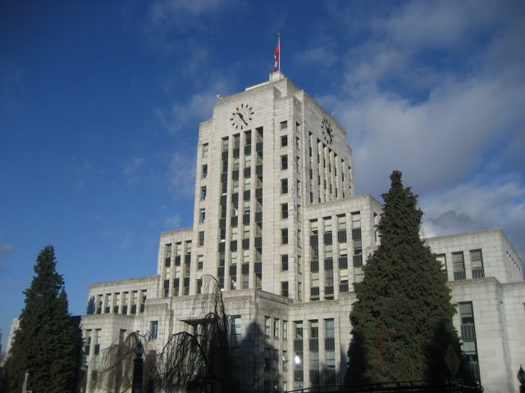
Who makes what public policy in Canada
Photo by Kyle Pearce: https://www.flickr.com/photos/keepitsurreal/2072552350

Slide 13
Who does public policy serve?
The role of government is to establish a compromise between various, sometimes conflicting interests in society
What is private interest?
What is public interest?
Who defines the public interest?
Why does it matter?

Slide 14
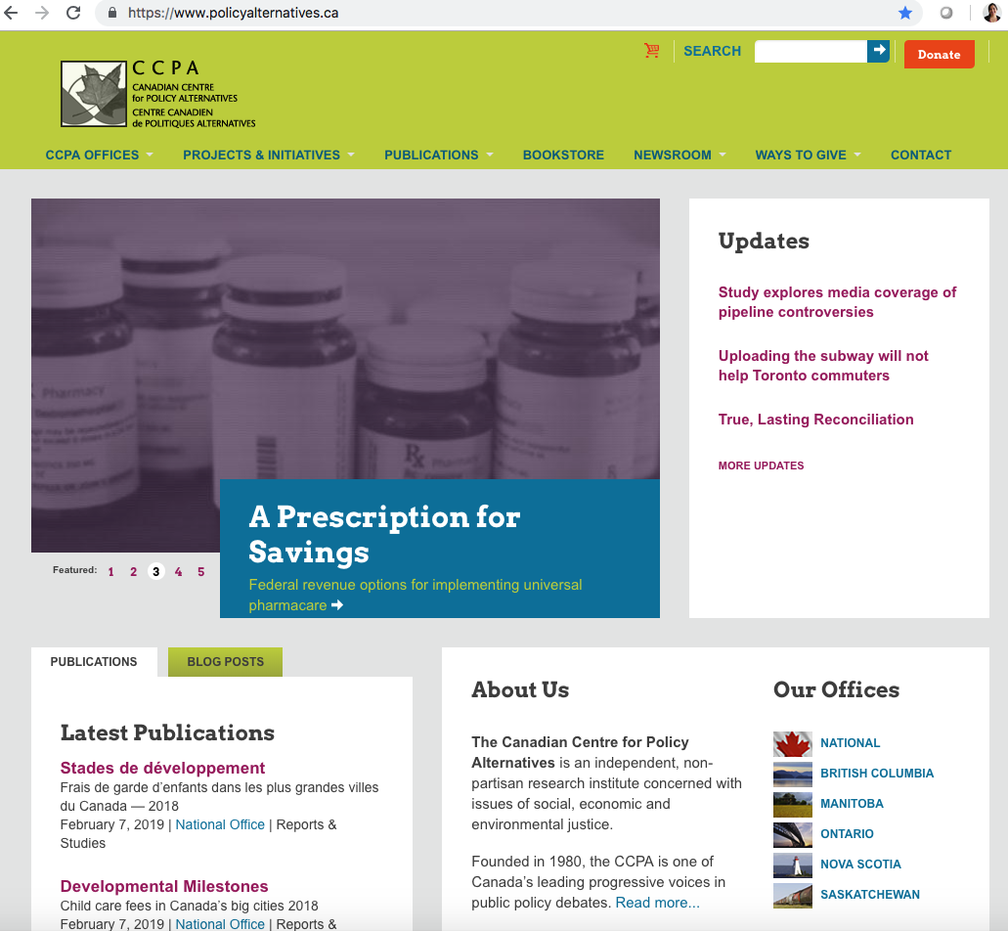

Slide 15

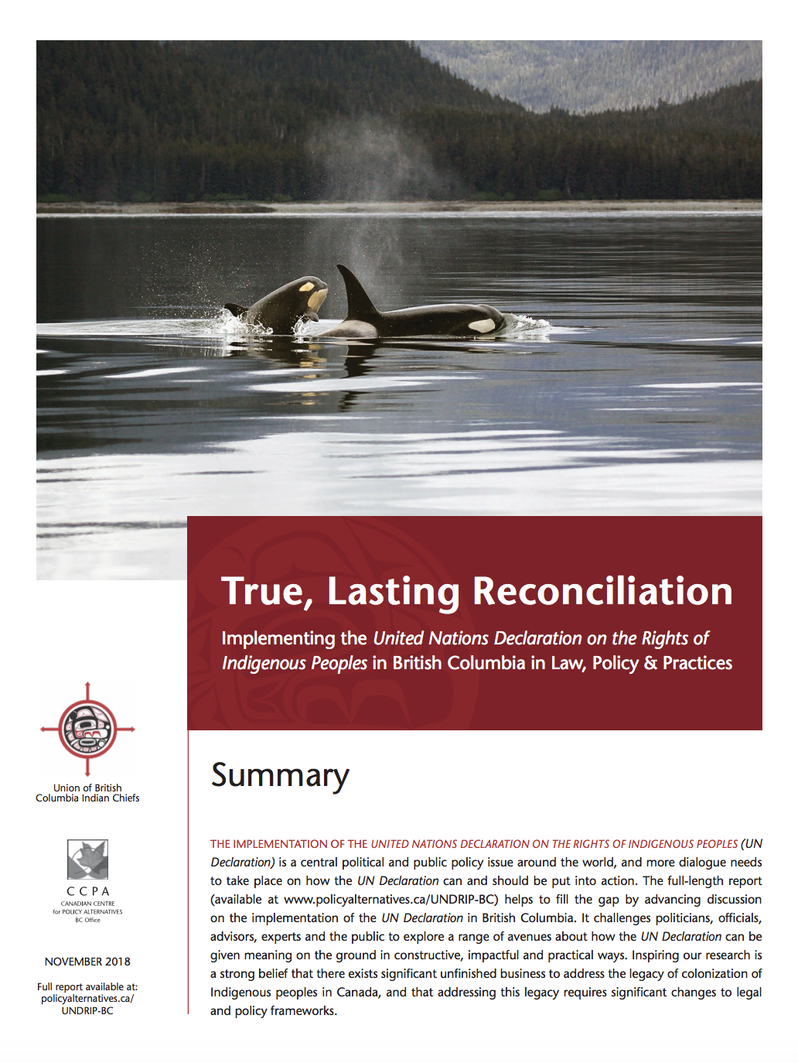



How we work to shape policy

Slide 16

Why we need you to help shape better policies?
Image: TeroVesalainen / Pixabay

Slide 17
What you can do to help shape policy
Learn more about the issue you care about
Find out if there are organizations or individuals who are already working on it
Talk to them, look for opportunities to get involved
Make your voice heard and amplify the voices of others

Slide 18
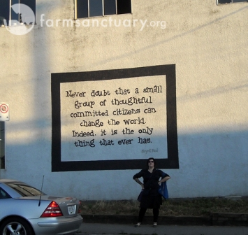
Food for thought
“Never doubt that a small group of thoughtful, committed citizens can change the world. Indeed, it is the only thing that ever has.”
Margaret Mead

Slide 19
Reflection activity
What is one example in your own community (whether your city, faith community, work, etc.) where the public and private interest might align?
What is one example where public and private good are in clear opposition?
What about examples where the lines are less clear and private and public interests may have shared goals and work towards common outcomes?

Slide 20
Reflection activity (in small groups)
What is one idea you have for changing public policy?
What goals will your public policy change achieve?
What level of government sets that policy? How might you be able to engage with the policy makers?
Who are the other players that might be affected by your proposed public positive change either positively or negatively?
How might you try to bring other people on board?

